Slide 1
SAFETY SELF BRIEFING
July 2nd – July 20th 2025

Slide 2
OBJECTIVES OF SAFETY BRIEFING:
to clarify operations on the airport
quick and better to understand safety rules
it provides a written guide, available to the pilot at any moment for consultation

Slide 3
AGENDA:
Airport access
Glider parking - Marshalling paths - Glider Weighing stations
Radio FREQs allocated for flight safety
Grid procedures for both take-off directions
Launching Procedures
Release areas
Tow-plane circuits as related to the various release points
Glider landing procedures

Slide 4
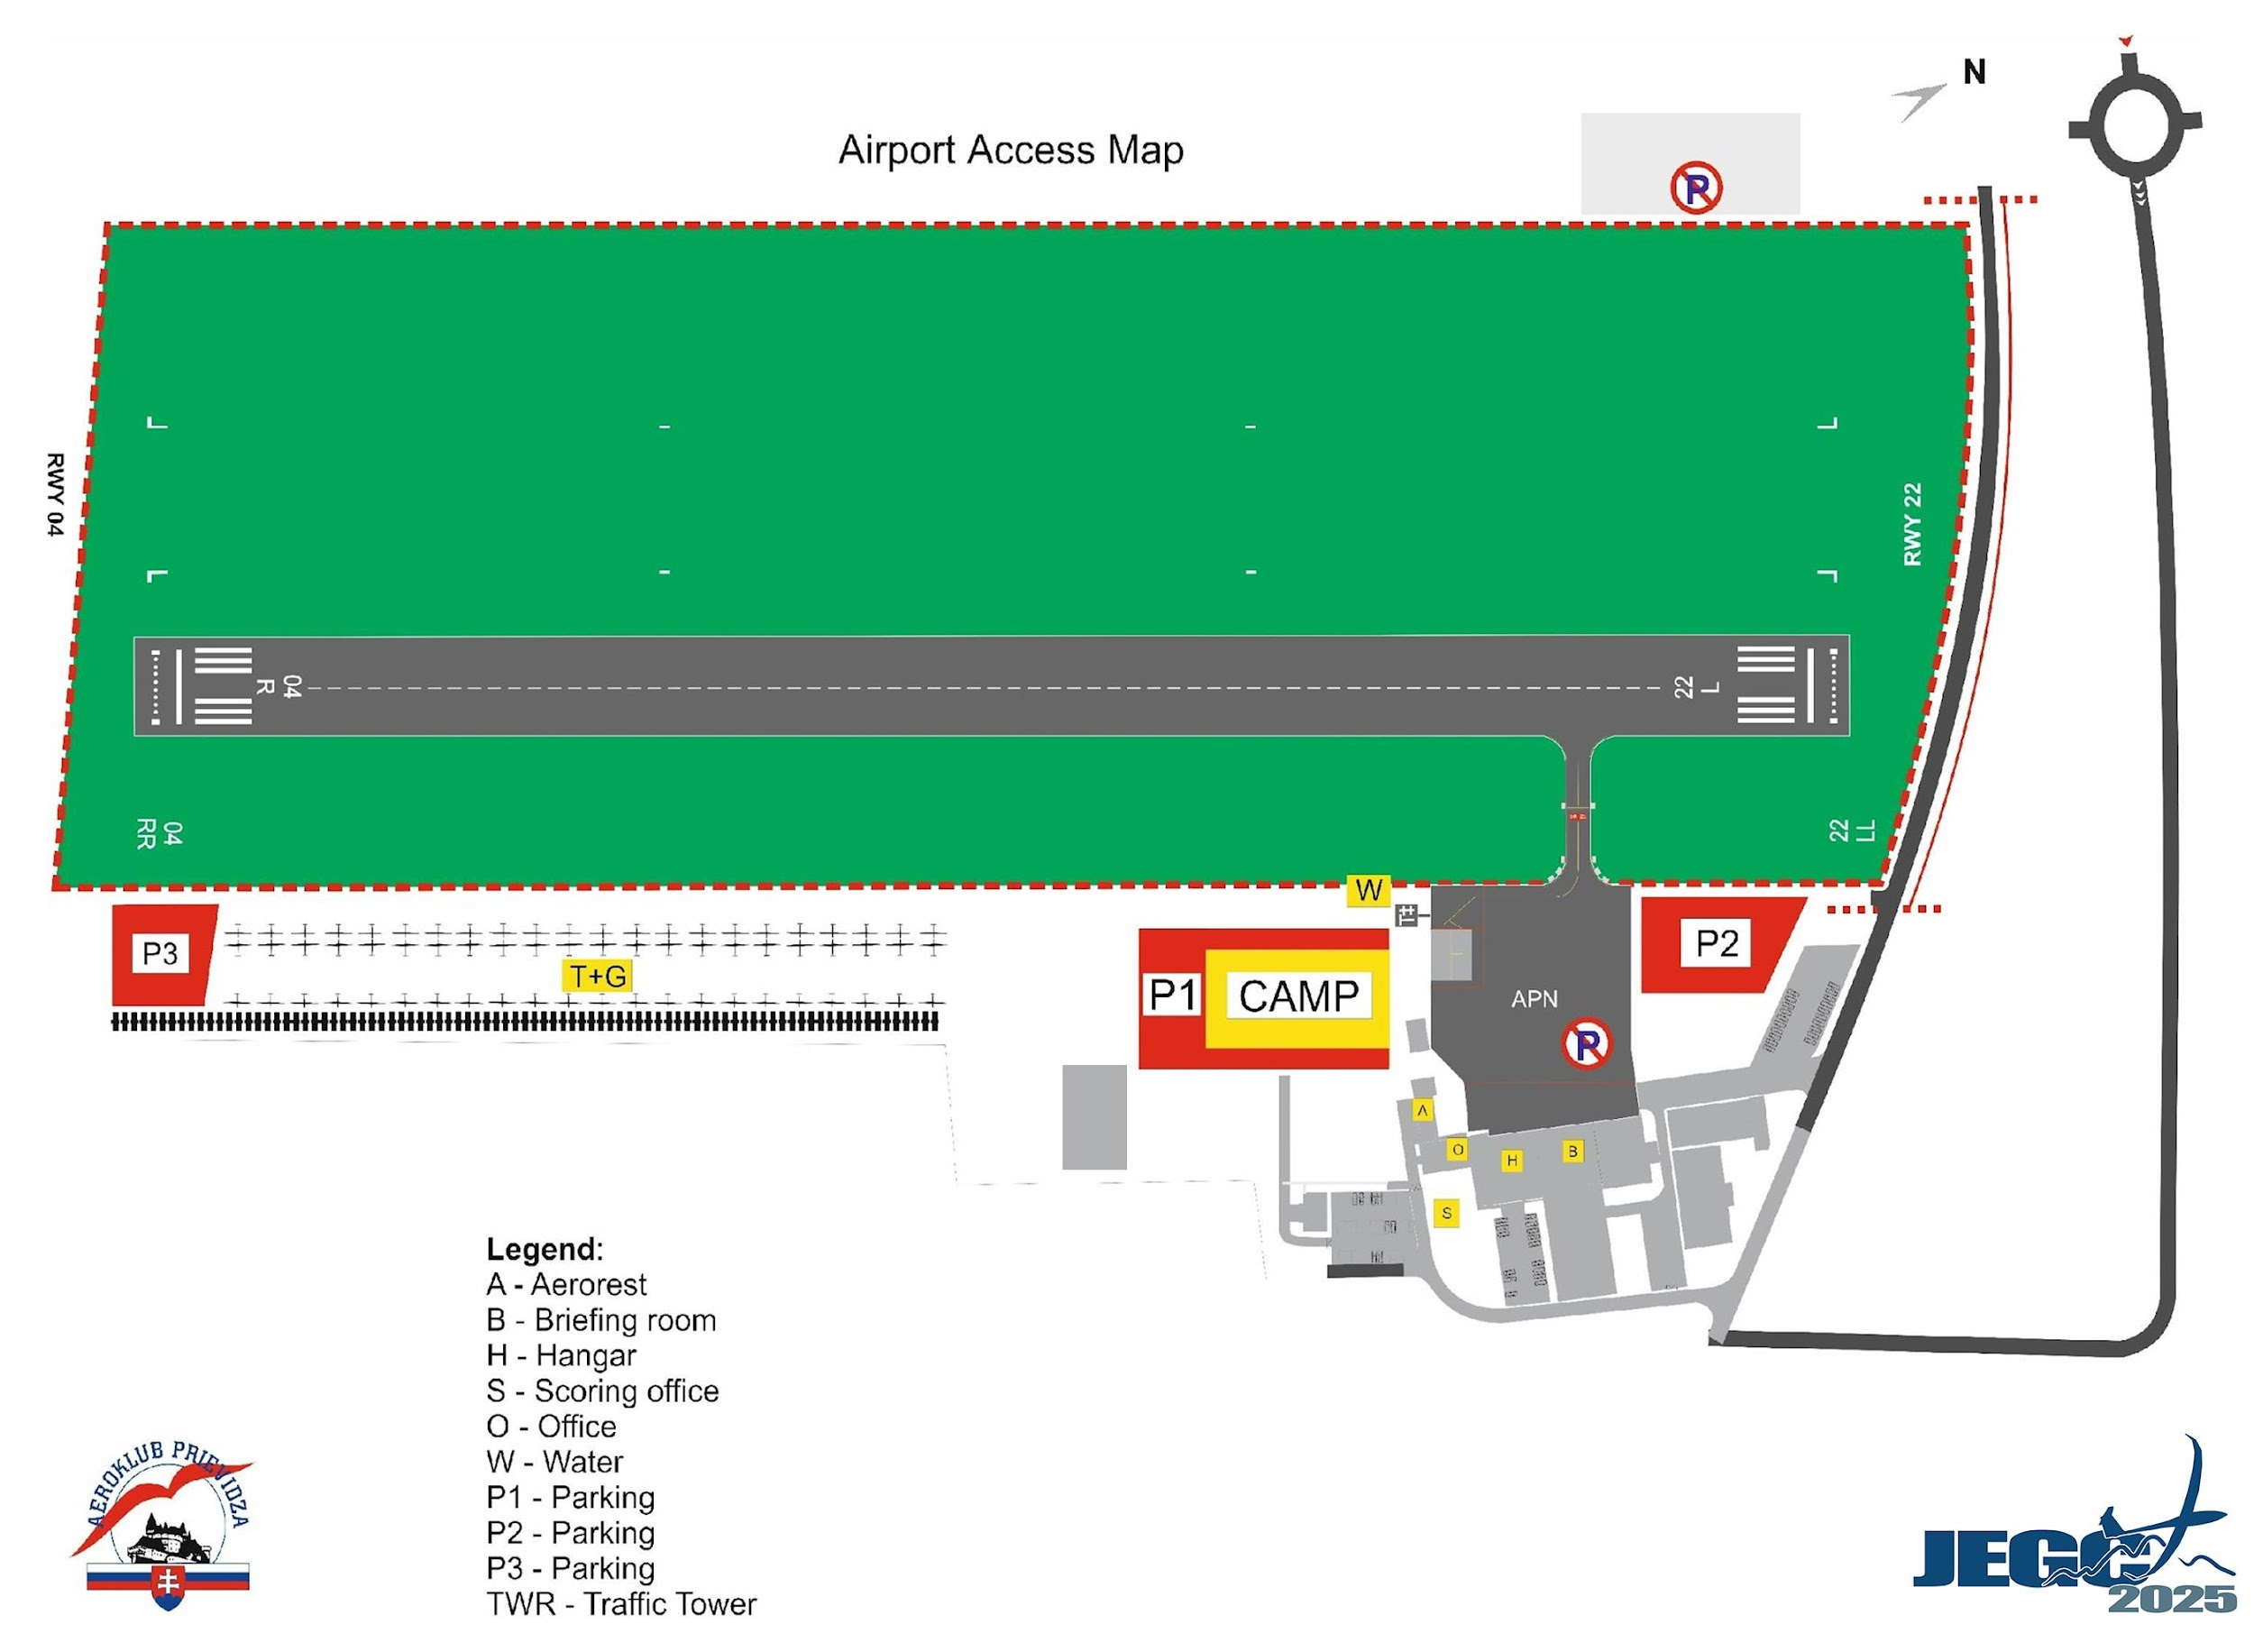
Airport Access + Bounderies

Slide 5
Ground Movement of People,
Cars, Trailers and Gliders
the next pictures show maps of airfield
(Picture1 & Picture 2)
show the access roads and the areas reserved for gliders, trailers, caravans, visiting airplanes and motor vehicles.

Slide 6
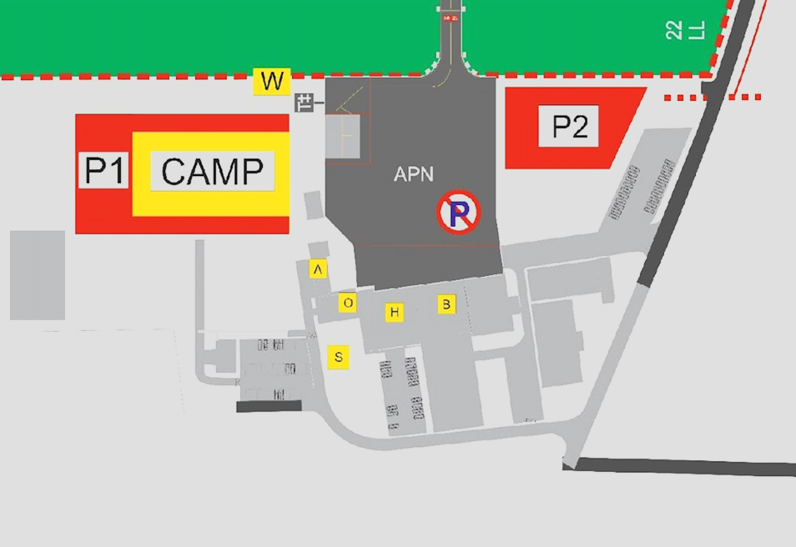
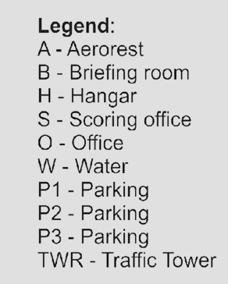
Airport Facilities Map

Slide 7
Ground Movement of People,
Cars, Trailers and Gliders
The pilots and their teams are kindly requested to comply with the following rules:
  the road marked in red
  must be used for both
  entering and leaving
  the airport

Slide 8
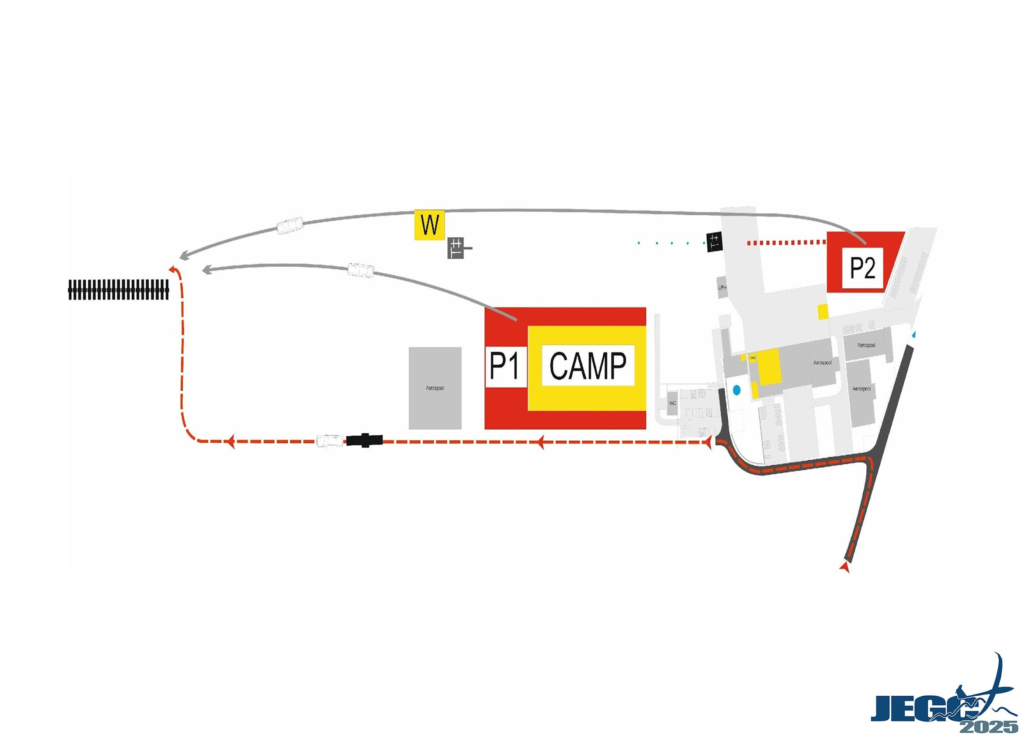
Ground Movement of People,
Cars, Trailers and Gliders

Slide 9
Glider Parking
Marshalling Paths
Glider Weighing Stations

Slide 10
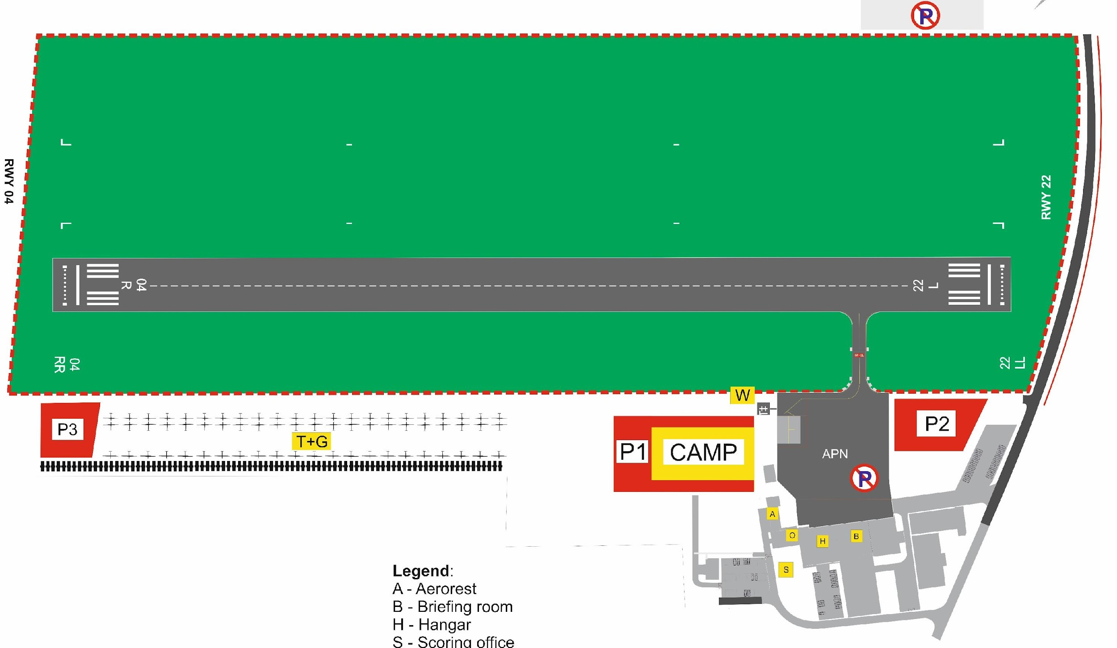
  The gliders may be filled from water tanks in the parking area “T&G” or directly from the designated water station “W”.

Slide 11
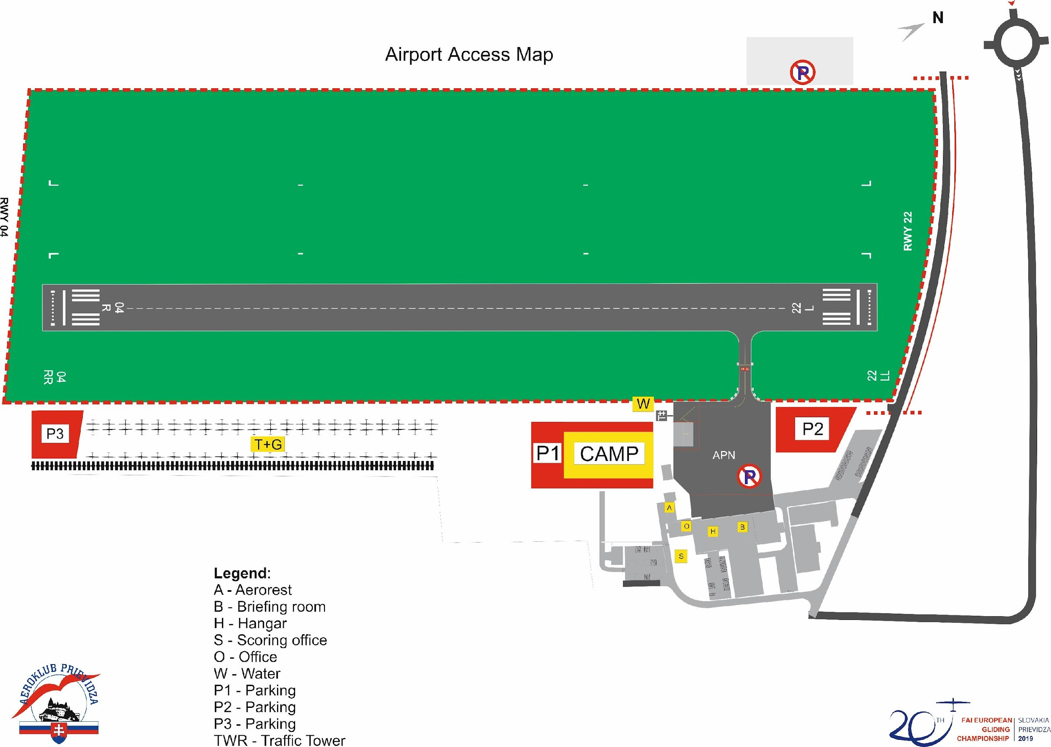
Airport Map
  All trailers and gliders have to be parked in the “T&G” parking area.

Slide 12
  The participants in the championship may park their motor vehicles in the areas “P1”, “P2” and “P3”. The speed limit for all vehicles in the airport area is 20km/h.
  “Campsite” is the area reserved for caravans and tents, without parking of the vehicles. The area is equipped with 220V power outlets

Slide 13
Self Briefing
Glider Parking
Ground Movement of People,
Cars, Trailers and Gliders
Every pilot will be assigned with his own glider parking slot, as a part of the registration procedure.
Glider parking slots will be grouped by Nation.
The parking area will be given to each team in order of arrival date to Prievidza airport.

Slide 14
3.
Radio FREQs
allocated for flight safety

Slide 15
Radio FREQs
for launches and re-landing during launches:
Call sign
PRIEVIDZA GROUND (FREQ 122.605 MHz)
Will be activated 30 minutes before the planed start
will be deactivated by opening the start line for the last starting competition class:
From beginning of the take off;
During the launch until they have left the release area;
In case of re-landing during take off.

Slide 16
Radio FREQs
for all airport operations, for competition purposes – start line, finish line:
Call sign
PRIEVIDZA TRAFFIC (FREQ 123,055 MHz)
After leaving the release area;
On the final glide from at least 10 km away from the finish
During the landing – from the moment pilots join the circuit
until they have left the runway

Slide 17
Radio FREQs
TEAM FREQUENCIES
The list of FREQ will be announced before the training period - assigned team frequencies for all team communication related to the contest.

Slide 18
4.
Grid procedures for both take-off directions

Slide 19
The Launch Grid
The grid order for each class will be drawn by lots during the first briefing
Gliders will be gridded in rows of 3 gliders
The grid order shall be rotated by 2 rows from back to front after each Championship day.
The grid will open at 8.15 AM LT and will close 15 minutes before the beginning of the launch time announced during the briefing.

Slide 20
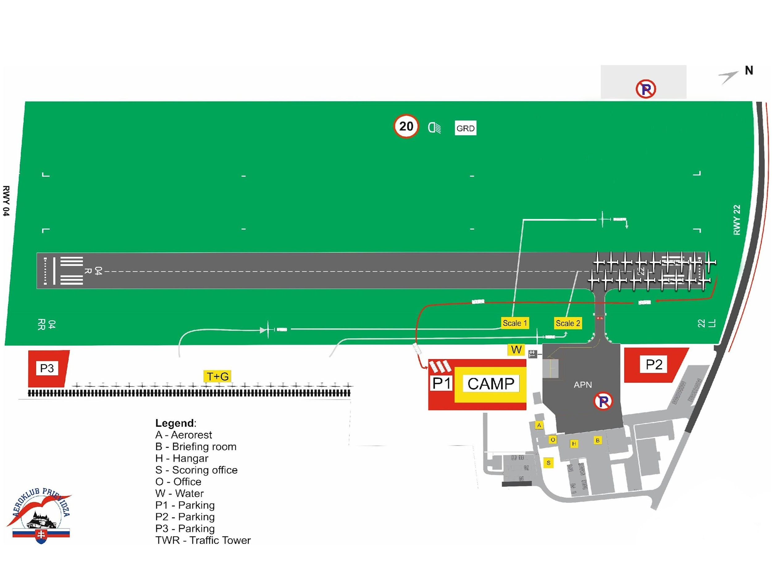
Glider Transport to the Grid - RWY 22
The gliders must be moved to the grid “GRD” via the weight bridges marked “Scale 1” and “Scale 2” as indicated on the map

Slide 21
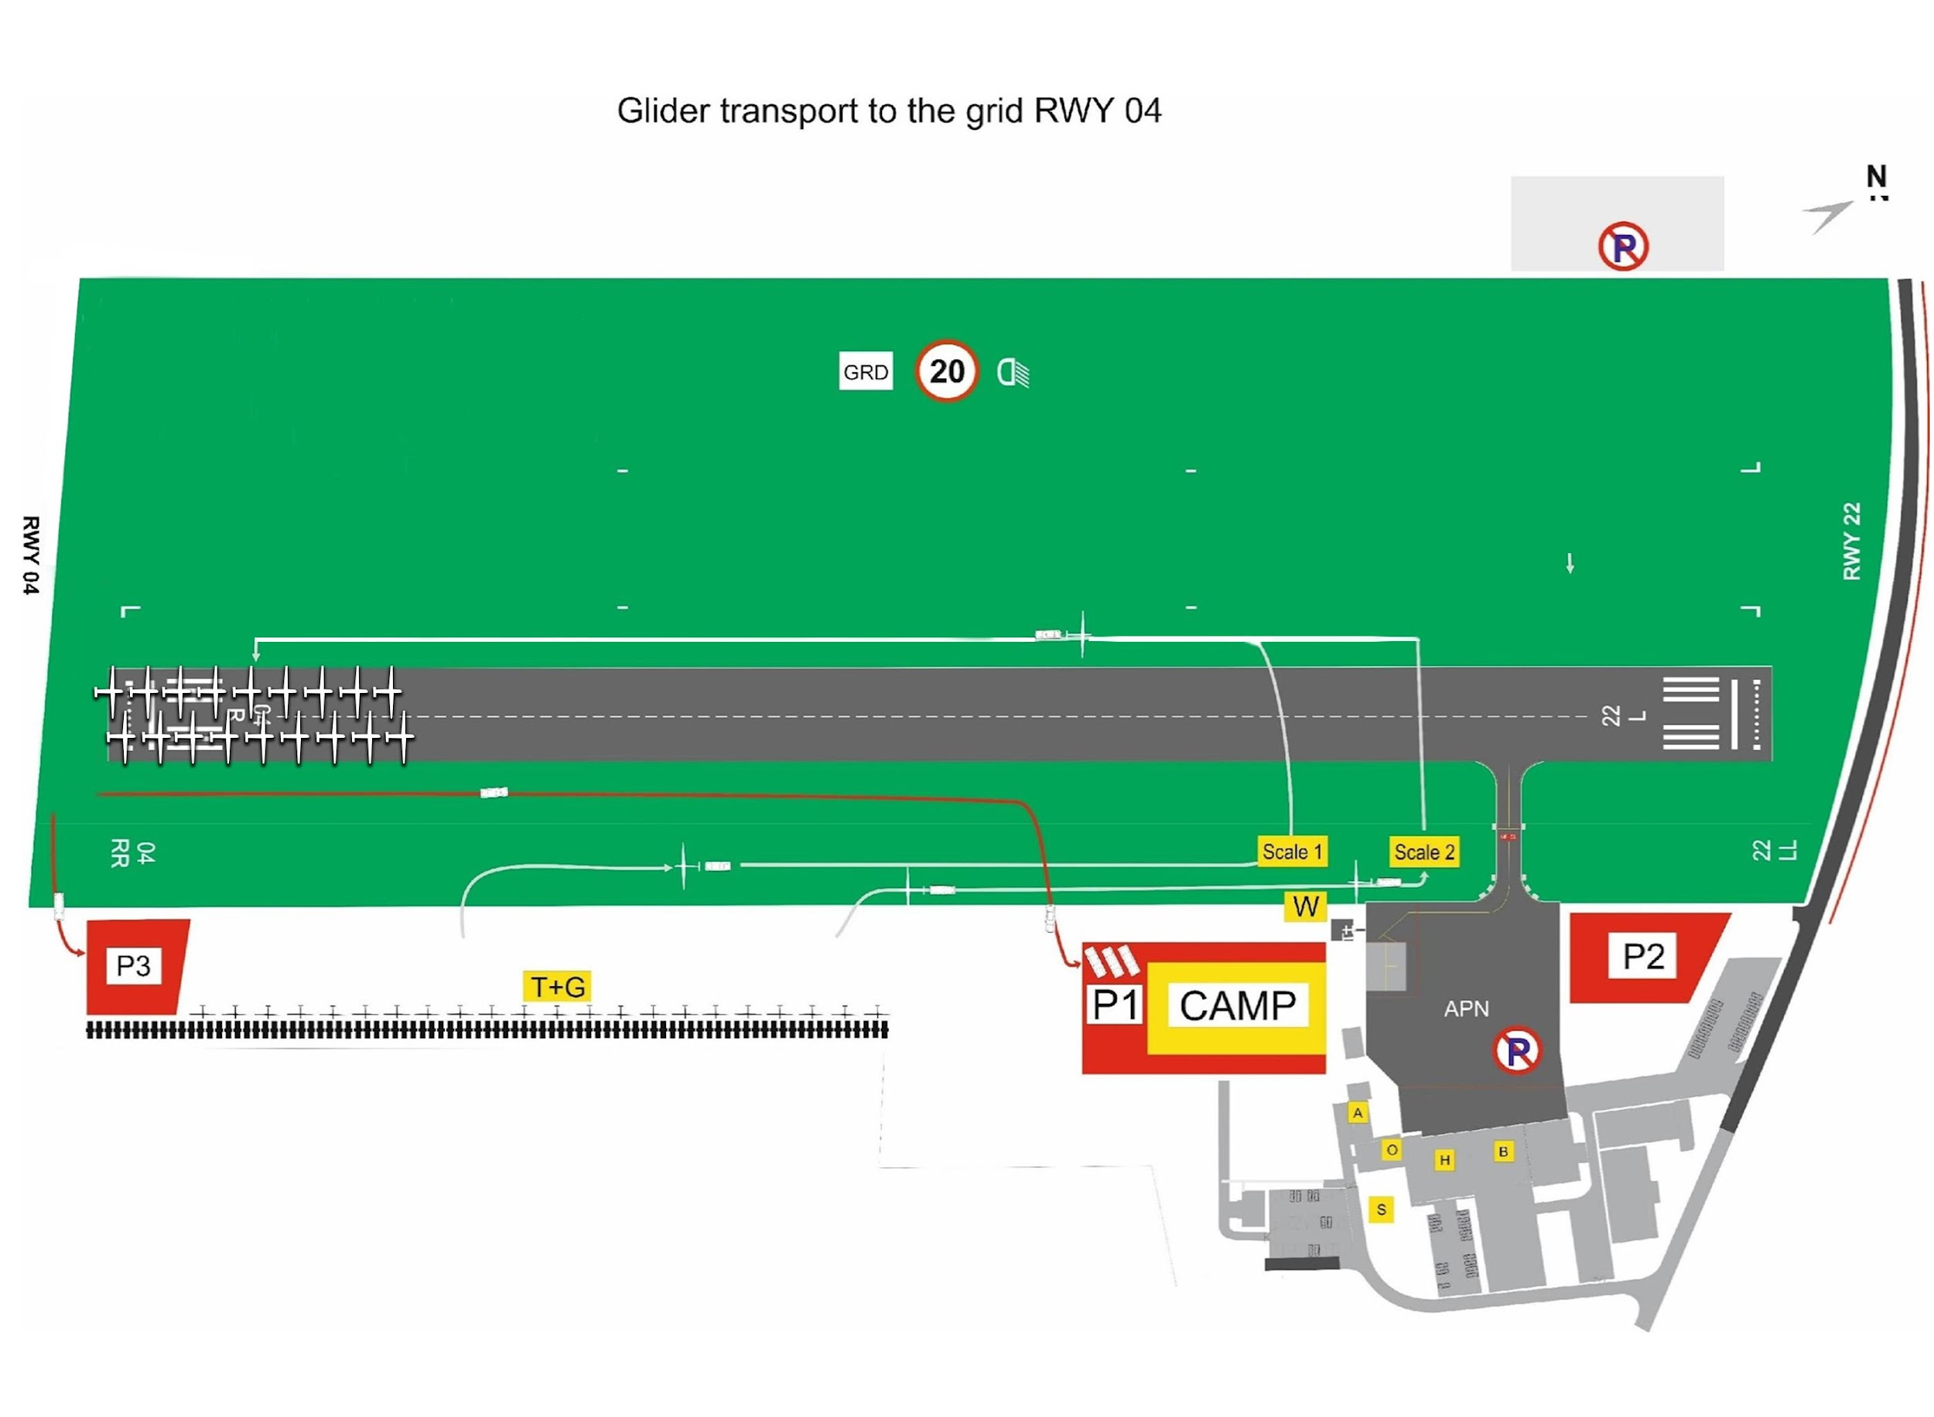
Glider Transport to the Grid - RWY 04
The gliders must be moved to the grid “GRD” via the weight bridges marked “Scale 1” and “Scale 2” as indicated on the map

Slide 22
The Launch Grid
Each glider shall be parked on his own line, and shall occupy the furthest available space
Cars shall be removed from the grid, and driven to the car parking area by the pilots or crews 15 minutes before the beginning of the launch time announced during the briefing
The take off order will be as following:
  1. Club Class
  2. Standard Class

Slide 23
5.
Launching Procedures

Slide 24
Take Off Procedures
will be announced during the briefing
however
the meteorological conditions
may require the competition director to update the take-off procedure before
the general take off

Slide 25
A. Take-off from the runway 22
Alternative A – Southern wind up to 10kt
Take-off from the runway 22
will be applied in case of:
southern wind up to 10 kt.
and northern wind up to 8 kt.
The glider take-off direction is 22, tow planes landing in direction 04.
If necessary, gliders may land back in direction 04.

Slide 26
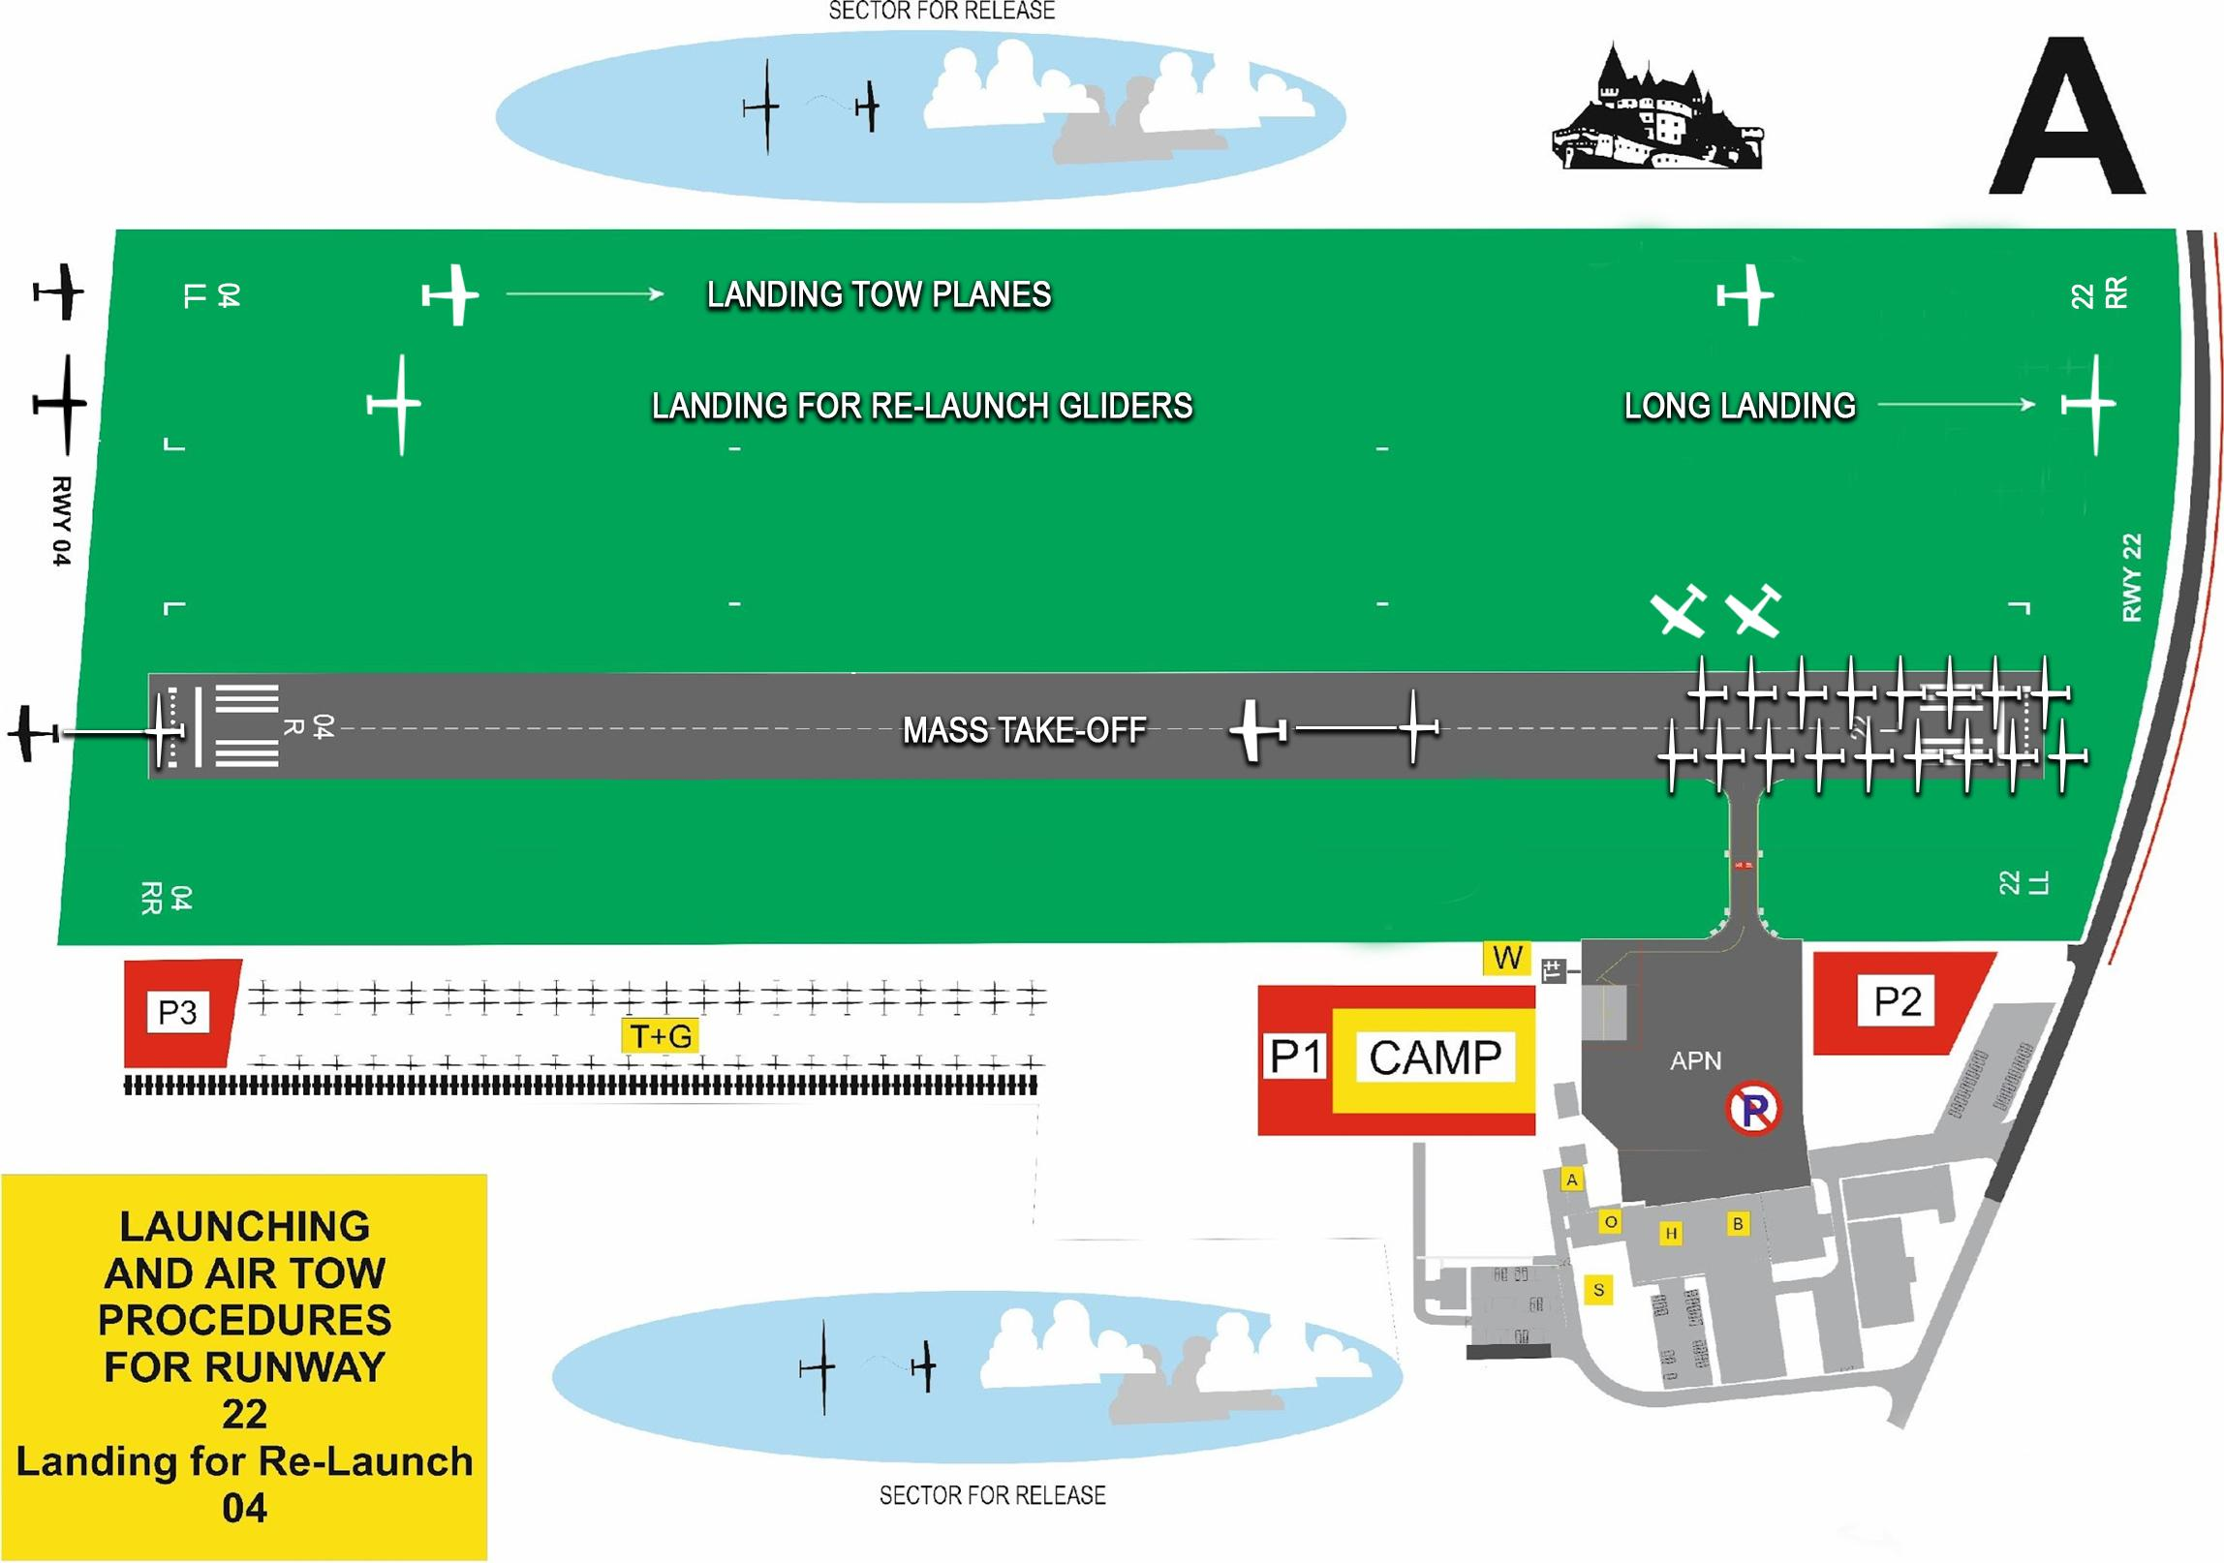

Slide 27
B. Take-off from the RWY 22
Alternative B – Southern wind up to 10kt
Take-off from the runway 22
will be applied in case of Southern wind more than 10 kt.
The glider take-off direction is 22, tow planes landing in direction 22.
If necessary gliders may land back in direction 22.

Slide 28
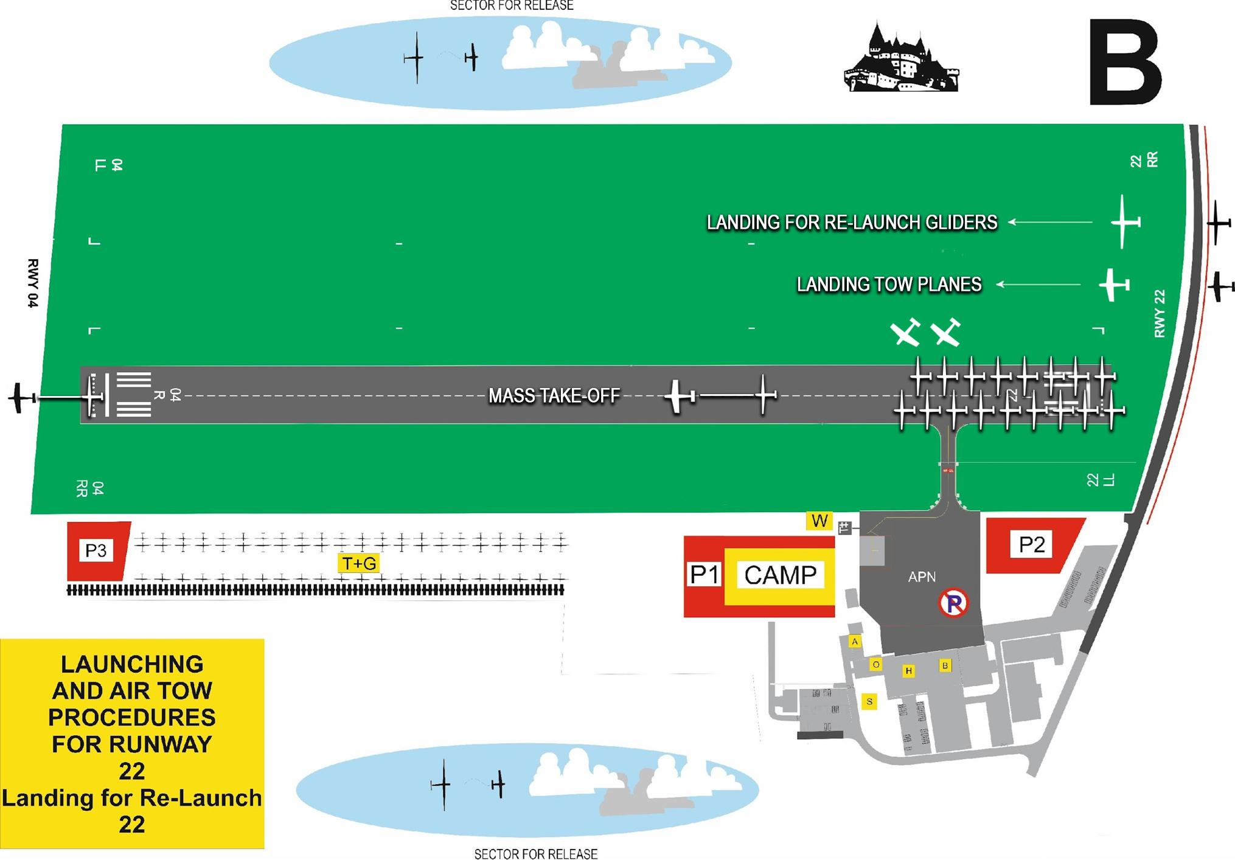

Slide 29
C. Take-off from the RWY 04
Alternative C – Northern wind more than 8 kt
C. Take-off from the runway 04
The glider take-off direction is 04
Tow planes landing in direction 04
If necessary, gliders may land back in direction 04.

Slide 30
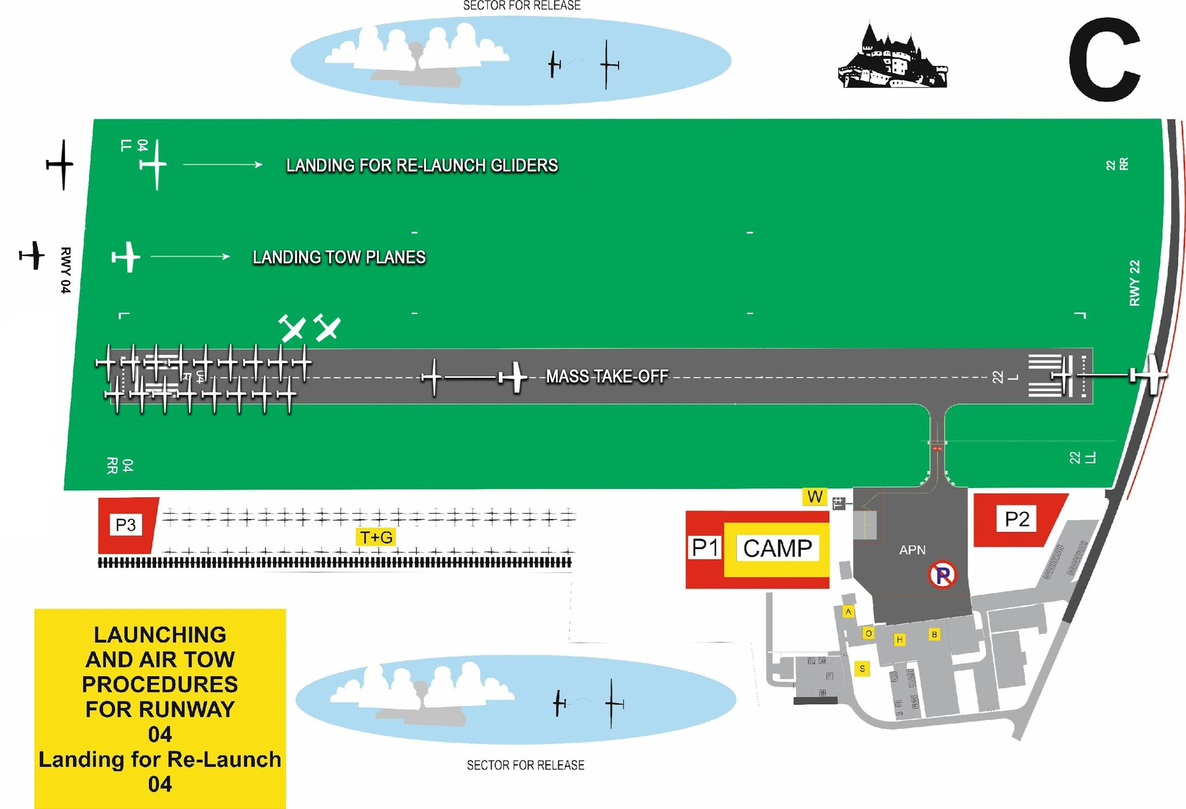

Slide 31
Launching
Where a glider´s take off:
is interrupted
or
glider lands prematurely,
the glider is moved back to the grid according to the depicted procedure for each take off alternative

Slide 32
Launch Procedures for Motor Gliders
shall :
follow the same climb-out path as the aero-towed gliders in their Class
and
shall shut down their MoP in the designated release area at or below the maximum release high.

Slide 33
Launch Procedures for Motor Gliders
Motor gliders requiring a second (or even third) launch must:
Land before the new launch.
The new launch has to be approved by the organisers
on the frequency 122,605 MHz before start line and 123,055 MHz after start line
and
it shall be conducted reflecting the sequence of landing times of other gliders in the same class.
After a new start, motor gliders shall follow the same climb-out path as the aero-towed gliders in their Class and shut down their MoP in the designated release area at or below the maximum release high.

Slide 34
6.
Release areas

Slide 35
Release Areas
The release areas for the given day will be specified during the briefing or will be updated before the start
Last time for glider releasing is signal from tow planes pilot by rocking wings
The gliders are releasing in the areas “Release sector 1”,“Release sector 2”
In maximum high 860m AMSL.

Slide 36
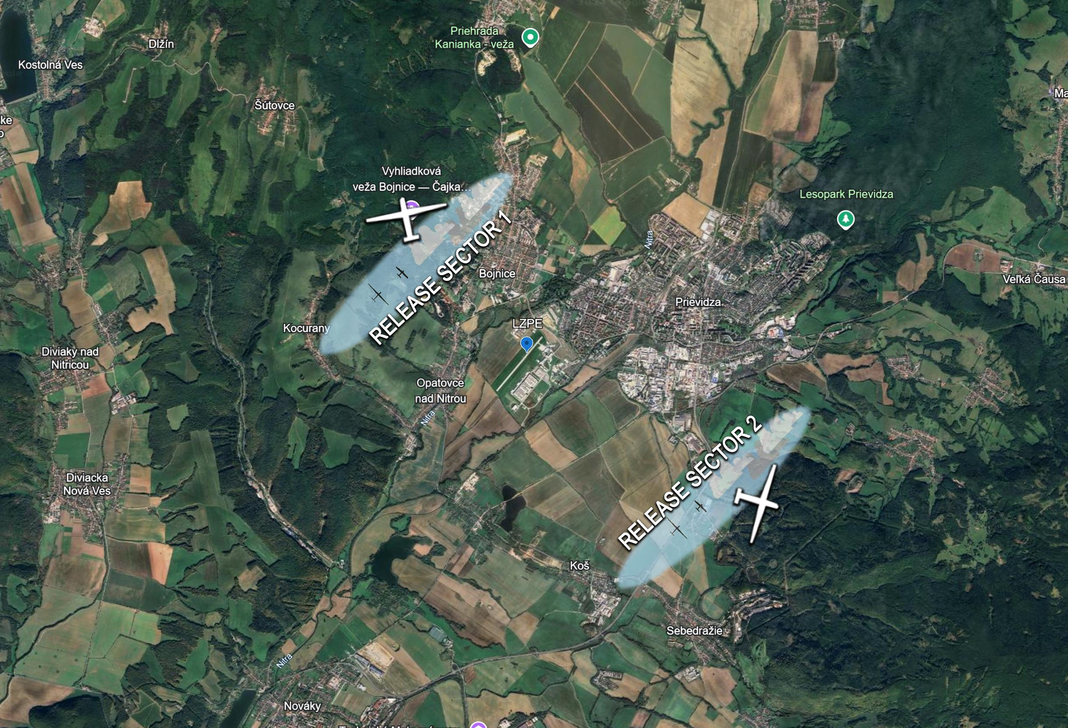

Slide 37
7.
Glider Landing Procedures

Slide 38
Finishing Procedures
Announcing of the arrivals will on frequency
123.055 MHz.
For announcing the arrivals:
Prievidza TRAFFIC (Competition number), (distance to finish line in km)
As soon as possible at 10km final or last control point of the task used for aligning the sailplanes in the same direction for the final.

Slide 39
Finishing Procedures
Prievidza TRAFFIC (Competition number), (distance to finish ring border, in km) - at 2km final.
Those pilots who have decided for a direct landing will say:
Prievidza TRAFFIC (Competition number) DIRECT LANDING (RWY specification: Left-Left, Left, Right, Right-Right )

Slide 40
Finishing Procedures
Those pilots who have decided for a speed finish, taking into account the altitude limits will say:
Prievidza TRAFFIC (Competition number) Circle to land
The procedures for joining the circuit of the runway in use for finishers will be specified at the briefing.

Slide 41
Finishing Option
Finish Ring The finish ring will be a circle with a 5km radius from finish point.

Slide 42
Minimum Height for the Finish
The minimum altitude, expressed in AMSL, for crossing the finish ring will be specified at the daily briefing. Due to geography around the airfield two finish Ring configurations will be used. Exact variant will be specified at daily briefing. Minimum altitude 460 AMSL (southerly directions) or 560 AMSL (northerly directions)

Slide 43
Minimum Height and
Maximum Altitude for the Finish
Note: The altitude for crossing the finish line will be checked on the flight records. Since this measurement may not be precise it is up to the pilots to take the right margin.
During final approach and/or before crossing the finish, pilots shall maintain a descending flight profile and cross the airfield boundary at a height which cannot endanger persons (seen or unseen), vessels, vehicles or structures.

Slide 44
Landing Procedures
The landing frequency is the same as the finish frequency
123.055 MHz call sign Prievidza TRAFFIC.
As a general rule,
direct landings will take place on the East part of the runway while circle to land and landings after speed finishes will take place on the West part of the runway
Pilots shall land as long as possible without changing direction.
Dangerous behaviour will be penalised.

Slide 45
Landing Procedures
If several pilots are landing together, the first pilot will land as close as possible to the Eastern edge of the runway
The next pilots a little more to the West.
Dangerous behaviour will be penalized.
Notes:
45

Slide 46
Landing Procedures
Not communicated and/or not approved short landing procedure will be considered as: “Incorrect landing procedure” and will be penalised as a safety violation!
The flight trace must not show excessive pull-ups or dives from 10km to landing. Excessive manoeuvres and pull-ups or dives more than 25m will be penalised as a safety violation!
Notes:
46

Slide 47
Landing Procedures
The aim is that all landing gliders must land as long as possible (without changing direction) to allow other gliders to land safely behind and to use as much runway as possible.
Landed gliders must be removed back from the runway as quickly as possible. For towing of gliders , dedicated paths must be used only.
Notes:
47

Slide 48
Arrivals on RWY 04
Approach from the South
the gliders landing after a straight-in approach for the runway 04 should land according to the above mentioned procedure – in the last third of the runway as much to the RIGHT as possible (from the landing direction).
the gliders which are not landing after straight-in approach should enter the LEFT-HAND traffic pattern for the runway 04 (the organisers may change this rule during the briefing) and continue landing according to the radio instructions.

Slide 49
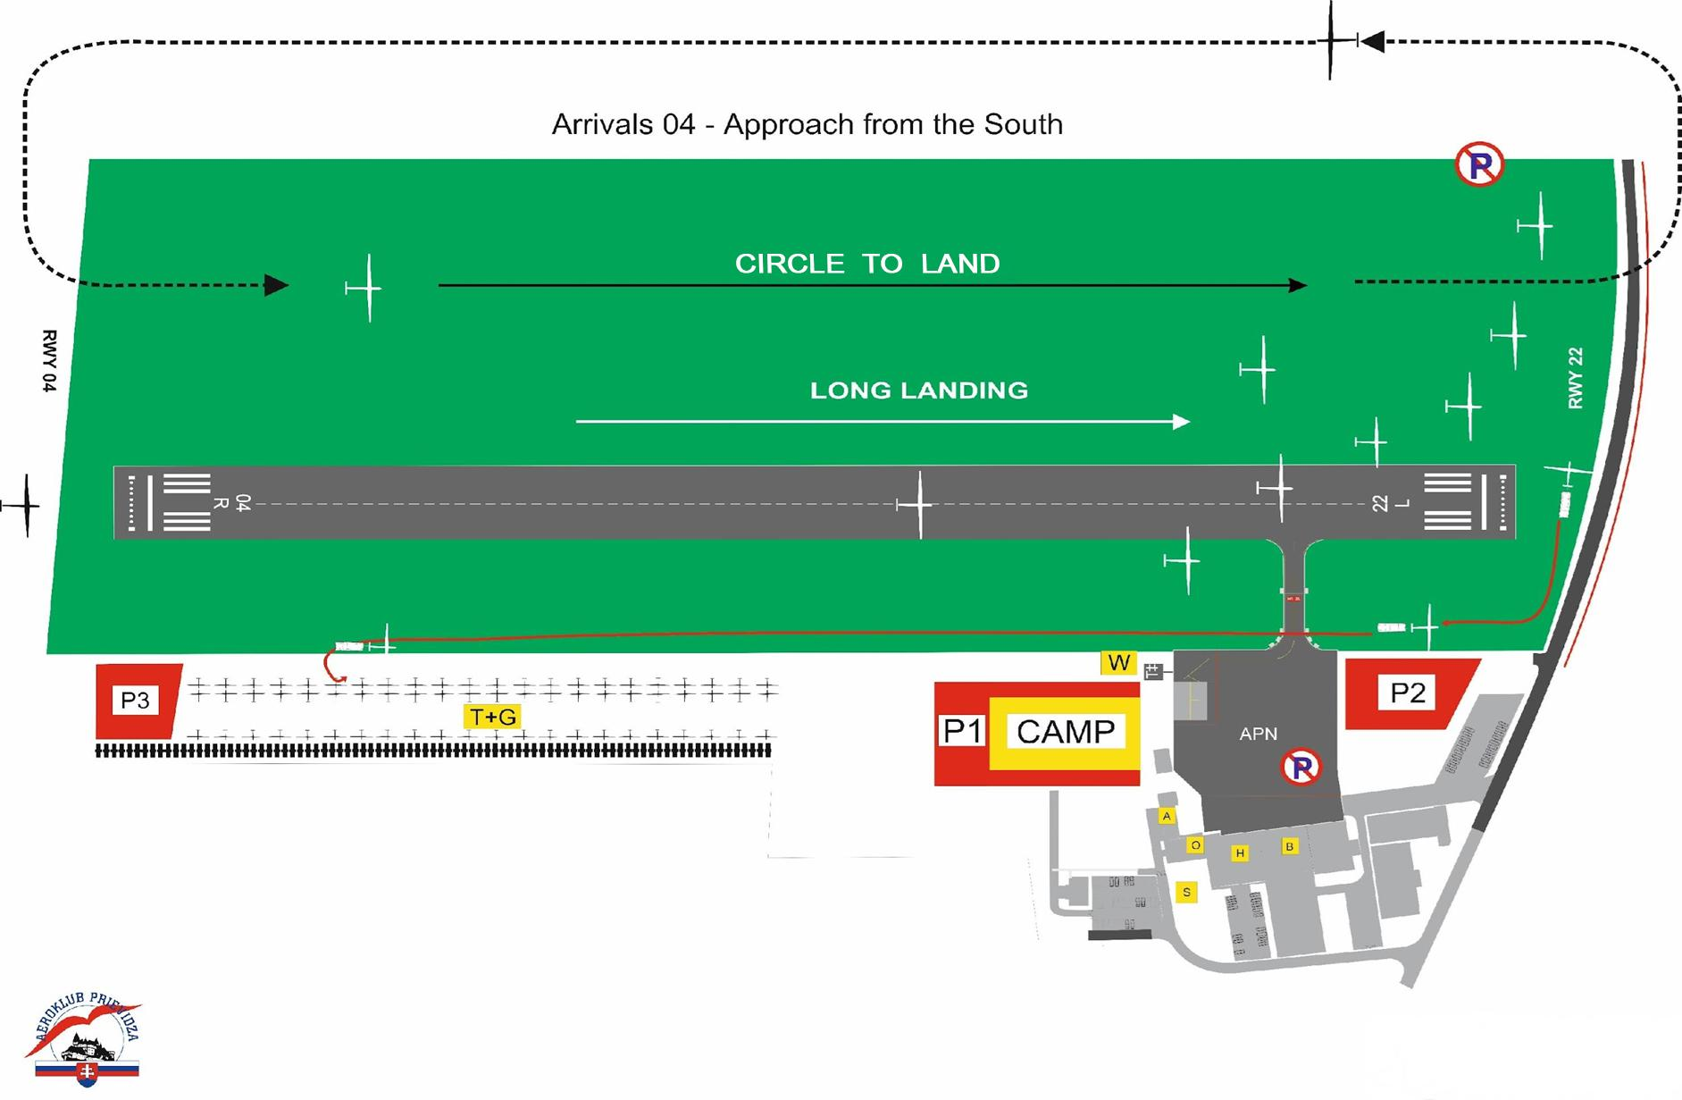
Arrivals on RWY 04
Approach from the South

Slide 50
Arrivals on RWY 22
Approach from the North
The gliders landing after a straight-in approach for the runway 22 should land according to the above mentioned procedure – in the last third of the runway as much to the LEFT as possible (from the landing direction).
The gliders which are not landing after straight-in approach should enter the RIGHT-HAND traffic pattern for the runway 22 (the organisers may change this rule during the briefing) and continue landing according to the radio instructions.
Notes:
50

Slide 51
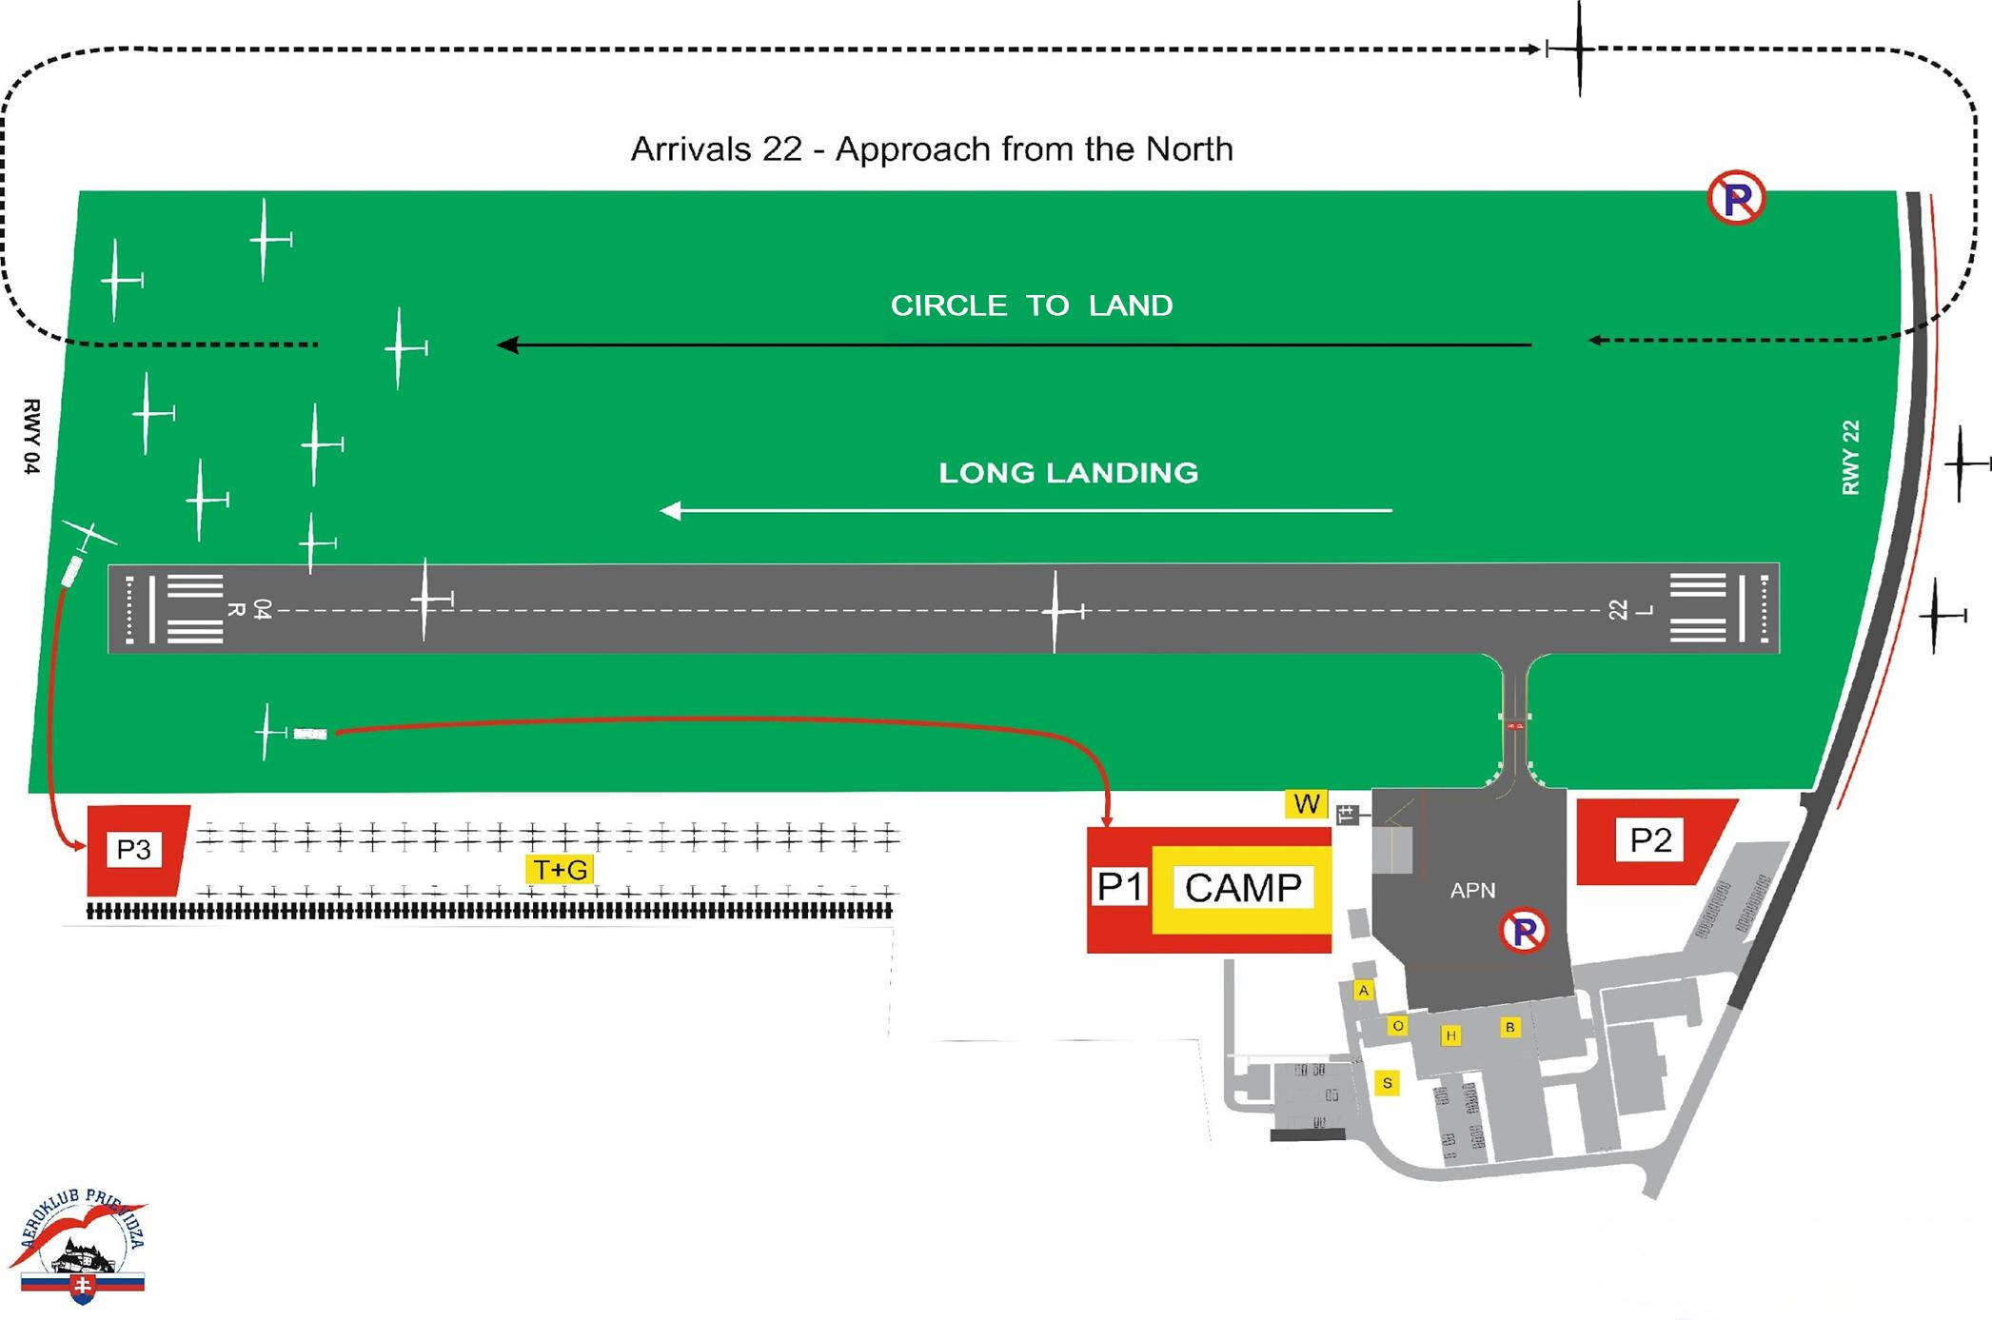
Arrivals on RWY 22
Approach from the North

Slide 52
Obstacles Around the Airport
High voltage line west of airport!!!
Voltage line in front of THR RWY22 !!!
2 Roads in front of THR RWY22 !!!
Approach from North - town Prievidza !!!
Chimney Nováky

Slide 53
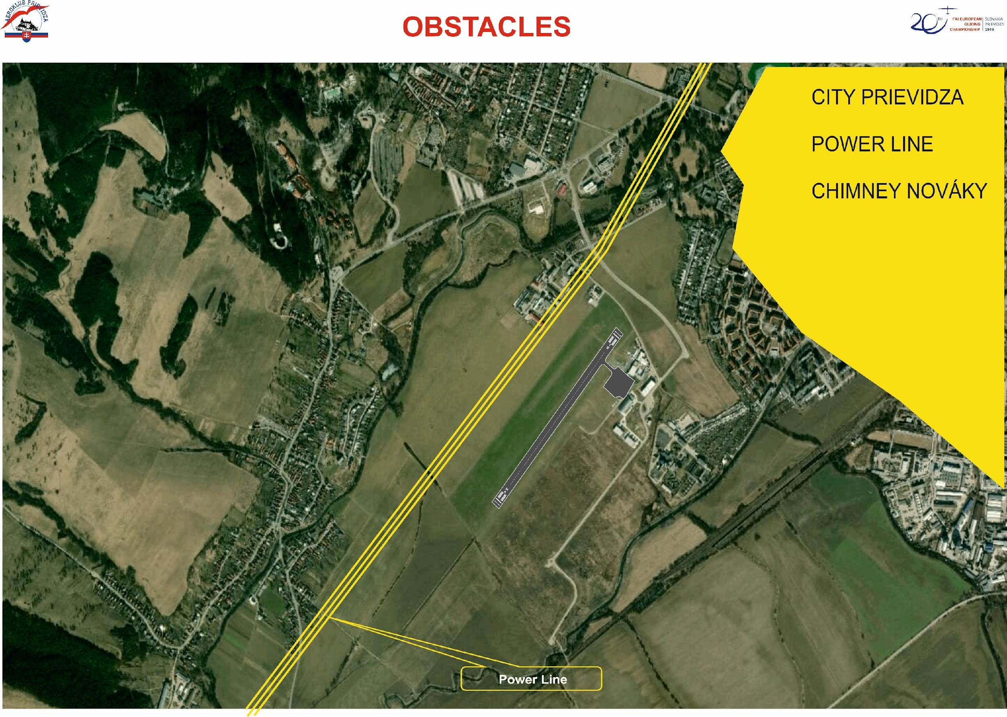
Obstacles Around the Airport

Slide 54
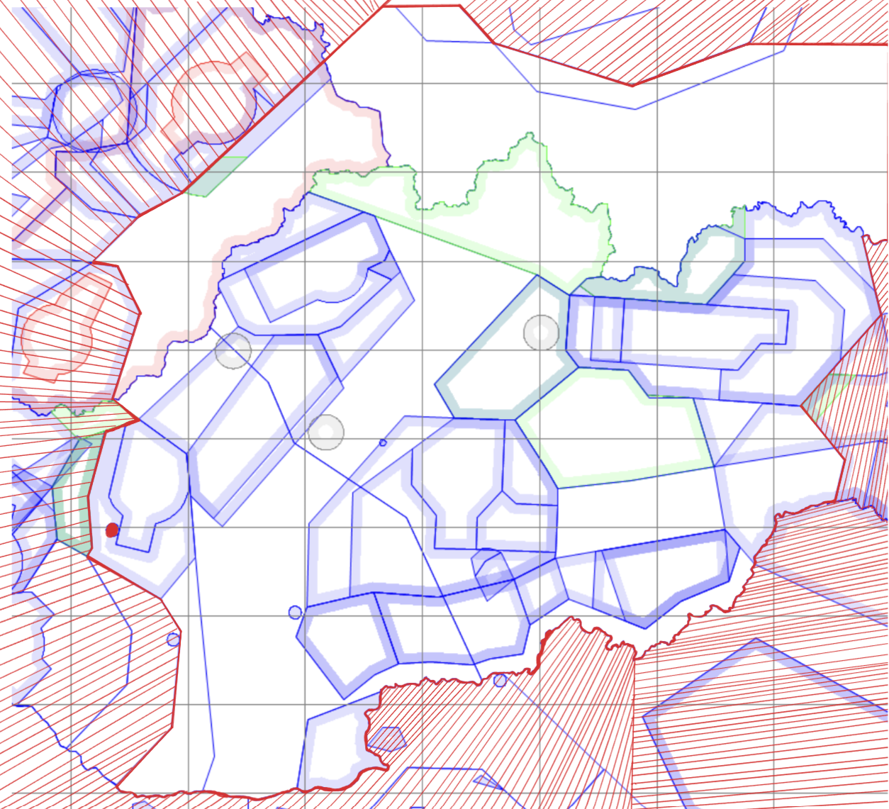
Competition Area

Slide 55
Thank you for reading
and
we will be happy to answer your questions

